Slide 1
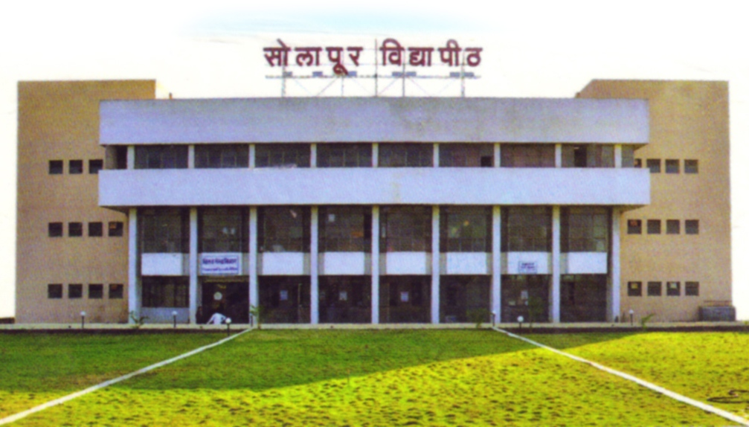
A Project Presentation on
“Impact of E- learning on student learning ” Department Of Statistics
P.A.H. Solapur University, Solapur
By
1. Rushikesh Bhusnar 2.Sneha Tavati
3.Pooja Nagtilak 4.Vidhya Kumbhar
Under the Guidance of
Mr. O. D. Ghadage Sir

Slide 2
Learning is a process of achieving knowledge, skill and performance. Thus learning is ultimately considered one of the fundamental pillars of society changes. Nowadays, technology has obviously made our lives easier. That means internet technology has been considered as an important medium for many aspects of our lives including academic learning. E - learning or online learning has received much attention in recent years globally.
The introduction of multimedia technologies and the internet in learning in many universities has been observed as a means of improving accessibility and quality of delivery and learning among the students and teachers. Many terms had been used to describe learning that delivered online or via the internet, ranging from distance education, computerized electronic learning, online learning, internet learning and many others. Numerous studies concluded that there were significant differences in learning outcomes between E - learning and traditional learning. However, and regardless of which one is beneficial still some people support the idea of traditional learning, while others believe in the E - learning system.

Slide 3
Data Information
We used primary data to study impact of online learning on students. Responses are collected through a tested questionnaire by using google form. Convenient sampling technique was used for the collection of data from the respondents.
From the population of size ______ we collected the sample of size 178. Out of these samples number of male students are 88 and number of female students are 90. also number of rural students are 116 and number of urban students are 62.

Slide 4
Objectives:
To study the effect of online learning on rural and urban students.
To study the effect of online learning on health of students.
To study the effect of online teaching on performance of students.
To study the difference between online and offline methods varied with gender.
To study is there ant difference in time spent for the study by students (online/offline).
To study the effect of online learning on eating habits of students.
To study the factors influencing students during online lectures.

Slide 5
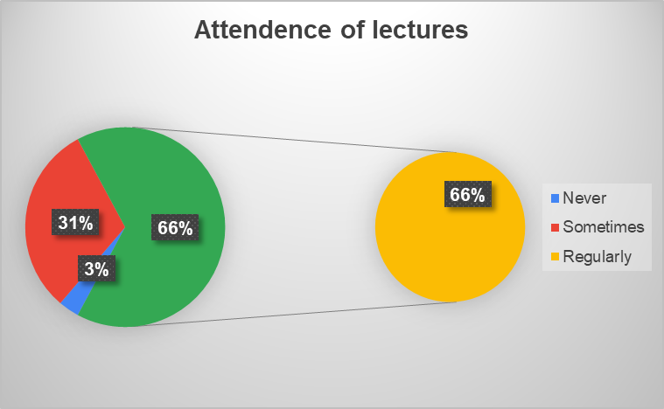
# Have you attend online lectures regularly?
From the above pie chart, 66% of students attend lectures regularly, 31% of students attend lectures sometimes and 3% of students never attend the lectures.

Slide 6
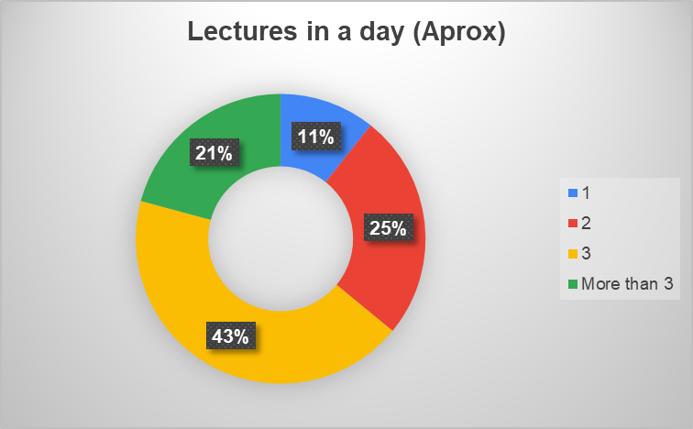
## How many lectures are taken in a day (approx.)?
From the above pie chart, approximately there are maximum 3 lectures taken in a day.

Slide 7
## Time spent for study during offline ## Time spent for studies during online learning? (in min) learning? (in min)
On comparing Graph-4 and Graph-5, the time spent for study during offline learning is more than the online learning.

Slide 8
## How much do you understand from online lectures?

Slide 9
## Does online learning improve your performance in exam
From above chart, there is no such improvement in students performance during online learning.

Slide 10
# With respect to practical knowledge which method do you prefer?
From the above graph, students are not getting proper practical knowledge from online learning.

Slide 11
# Does online learning method affected on your time management skills?
From above pie chart, there is positive effect of online learning on time management skill.

Slide 12
# Did you participate in online conversation with your lecturer during the class?
From above graph, maximum number of students participating in online lectures by messaging in chat box comparatively by speaking.

Slide 13
## Was there adequate technical support if you encountered Difficulties?
From above graph, students getting adequate technical support when they encountered difficulties during the online lectures.

Slide 14
## Which body part/s pains due to continuous online lectures?
Eyes and head most affected body parts due to online learning.

Slide 15
#Does online learning affected your eating habits? #Does online learning affected your obesity?

Slide 16
## Are you doing any other activities simultaneously during online lectures?
a
Form the above graph, it concludes that students doesn't focus 100% on online lecture by simultaneously doing other activities.

Slide 17
# In future which method do you prefer for learning? # In future which pattern of exam do you prefer?
From above graph, student’s future preference of learning method is offline.
From above graph, student’s future preference of exam pattern is offline.
More percentage of students preferred offline learning method and also offline exam pattern.

Slide 18
#CHI SQUARE TEST:
The Chi-square test of independence is used to determine if there is a significant relationship between two attributes
The data can be displayed in contingency table where each row represents a category for one attributes and each column represents a category for the other .
Decision Rule: Reject Ho, if p value is less than alpha, otherwise we fail to reject Ho.

Slide 19
# Hypothesis:
H₀: There is no significant difference between background of student and regular attendants of online lectures.
v/s
H₁:There is significant difference between background of student and regular attendants of online lectures.
Observed frequency table:
Row Labels | Never | Regularly | Sometimes | Grand Total
Rural | 3 | 72 | 41 | 116
Urban | 3 | 45 | 14 | 62
Grand Total | 6 | 117 | 55 | 178

Slide 20
Expected frequency table:
Row Labels | Never | Regularly | Sometimes | Grand Total
Rural | 3.91 | 76.25 | 35.84 | 116
Urban | 2.09 | 40.75 | 19.16 | 62
Grand Total | 6 | 117 | 55 | 178
Here,
P-value = 0.18106
Conclusion : we fail to reject H0 at 5% level of significance.
Therefore, background of student and regular attendants of lecture
are independent.

Slide 21
# Hypothesis:
H₀: There is no significant difference between background of student and future preference of learning method.
v/s
H₁: There is no significant difference between background of student and future preference of learning method.
Observed frequency table:
Count of Background of student | Column Labels
Row Labels | Offline | Online | Grand Total
Rural | 103 | 13 | 116
Urban | 57 | 5 | 62
Grand Total | 160 | 18 | 178

Slide 22
Expected frequency table:
Row Labels | Offline | Online | Grand Total
Rural | 104.27 | 11.73 | 116
Urban | 55.73 | 6.27 | 62
Grand Total | 160 | 18 | 178
P value = 0.50760
Conclusion: we fail to reject H0 at 0.05% level of significance.
Therefore, background of student and future preference of learning
method are independent.

Slide 23
# Hypothesis:
A: Gender of student
B: Future preference of learning method
H0: Attribute A and B and independent.
v/s
H1: Attribute A and B and dependent
Observed frequency table:
Count of Gender:- | Column Labels
Row Labels | Offline | Online | Grand Total
Female | 80 | 10 | 90
Male | 80 | 8 | 88
Grand Total | 160 | 18 | 178

Slide 24
Expected frequency table:
Row Labels | Offline | Online | Grand Total
Female | 80 | 10 | 90
Male | 80 | 8 | 88
Grand Total | 160 | 18 | 178
As, P value > 0.05
i.e. 0.6549 > 0.05
Conclusion: we fail to reject H0 at 0.05% level of significance.
Therefore, There is no significant difference between online and
offline lecture varied with gender

Slide 25
# Hypothesis:
A: Gender of student.
B: Future preference for exam pattern.
H0: Attribute A and B and independent.
v/s
H1: Attribute A and B and dependent.
Observed frequency table:
Row Labels | Offline | Online | Grand Total
Female | 74 | 16 | 90
Male | 76 | 12 | 88
Grand Total | 150 | 28 | 178

Slide 26
Expected frequency table:
Row Labels | Offline | Online | Grand Total
Female | 75.84 | 14.16 | 90
Male | 74.16 | 13.84 | 88
Grand Total | 150 | 28 | 178
As, P value > 0.05
i.e. 0.7635 > 0.05
Conclusion: we fail to reject H0 at 0.05% level of significance.
Therefore, There is no significant difference between future preference
for exam pattern and gender

Slide 27
Thank you…..

